Slide 1
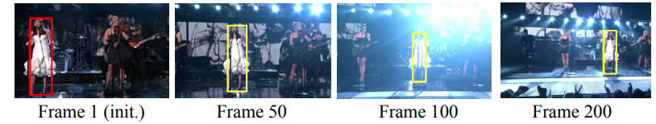
Fully-Convolutional Siamese Networks for Object Tracking
Luca et. al
University of Oxford: Reference
– Review by Kapil Wanaskar, SJSU
Notes:
Innovative Approach: Introduce the paper's cutting-edge method in object tracking,
highlighting the novel use of fully-convolutional Siamese networks.
Training from Scratch: Mention the significance of training the network from the ground up using the ImageNet Video dataset,
emphasizing its potential for learning robust features.
Real-time Tracking: Discuss the relevance of the network's ability to track objects in real-time,
which is crucial for applications in surveillance, autonomous vehicles, and augmented reality.
Robustness without Updates: Point out the network's robustness in tracking
despite not performing any model updates after the initial frame,
a substantial deviation from traditional methods that may require frequent updates.
Challenging Scenarios: Prepare to delve into the paper's exploration of the network's performance in challenging tracking scenarios,
such as dealing with motion blur and drastic appearance changes, which are common in real-world settings.

Slide 2
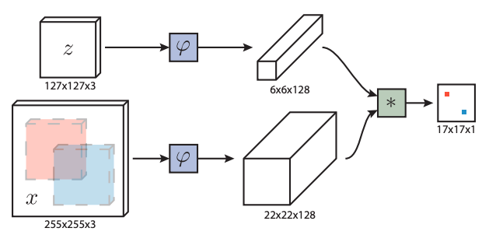
Fig. 1: Fully-convolutional Siamese architecture
Notes:
Input Processing: The network takes dual inputs, a reference image 'z' and a search image 'x',
which are processed through a shared network 'ϕ',
resulting in feature maps of 6x6x128 for 'z' and 22x22x128 for 'x'.
Feature Comparison: These feature maps undergo cross-correlation to generate a 17x17x1 score map
that indicates the similarity between the reference and the search image,
with color-coding to highlight similar regions.
Adaptive Architecture: The fully convolutional design of the network allows it to handle varying input sizes,
directly influencing the dimensions of the output score map.
Efficient Similarity Evaluation: The network performs a single-pass evaluation to compute similarities for all sub-windows,
outputting a scalar-valued 2D map that scales with the search image size.
Visual Similarity Indication: The score map uses color coding, such as red and blue,
to visually denote levels of similarity, aiding in rapid identification of the object's location.

Slide 3
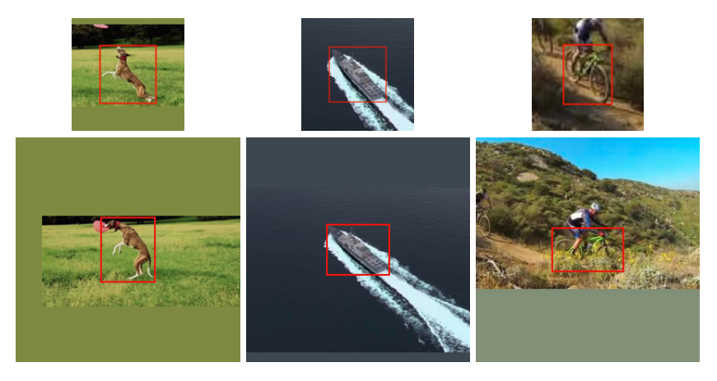
Fig. 2: Training pairs extracted from the same video
Notes:
1. Training Pairs: The images depict pairs used for training a tracking algorithm,
with one being an exemplar and the other a search image from the same video.
2. Source Consistency: Each pair is drawn from a single video,
ensuring consistency in appearance and context for the tracking algorithm.
3. Exemplar Focus: The exemplar images feature a target object or individual within a red bounding box,
serving as the reference for the search image.
4. Search Image Context: The corresponding search images provide a wider context,
showing where the target object appears within a larger scene.
5. Handling Borders: When parts of the target extend outside the image frame,
the vacant areas are filled with the mean RGB value to maintain input size consistency.

Slide 4
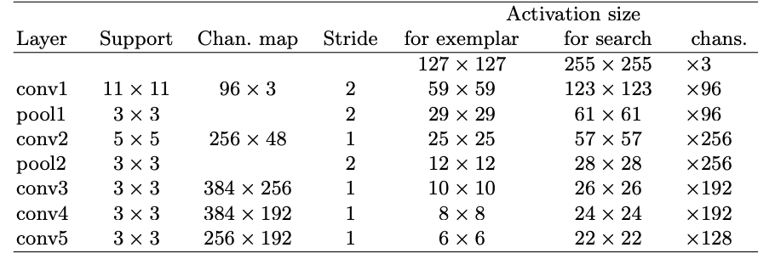
Table 1: Architecture of convolutional embedding function
Notes:
Layers: The table lists layers in a convolutional neural network (CNN)
including convolutional layers (conv) and pooling layers (pool).
Support: Indicates the size of filters (or kernels) used in layers,
e.g., 11x11 in conv1.
Channel Map: Shows the number of input and output channels for each layer,
e.g., 96 x 3 means 3 input channels and 96 output feature maps in conv1.
Stride: The step size the filters move;
a stride of 2 means 2-pixel steps across the image.
Activation Size for Exemplar: The dimensions of feature maps after each layer for an exemplar input,
starting at 127x127 and reducing to 6x6 by conv5.
Activation Size for Search: Similar to exemplar, but for a search input,
starting at 255x255 and ending at 22x22 in conv5.
Output Channels: Number of feature channels output by each layer,
indicating the complexity and depth of features extracted.
Conv Layers: Involved in filtering the input to create feature maps
that highlight specific features within the data.
Pool Layers: Reduce the dimensionality of the feature maps,
making the representation smaller and more manageable.
Architecture Purpose: This CNN architecture is structured
to efficiently process and transform input images for object recognition.

Slide 5
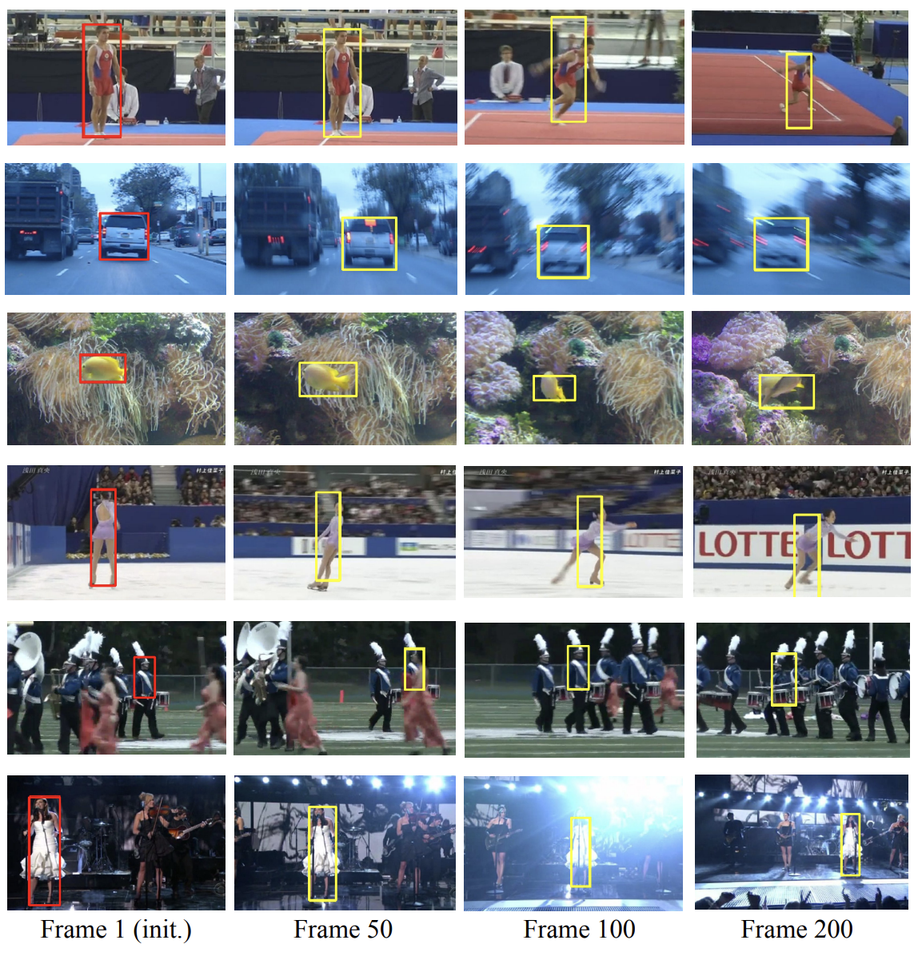
Notes:
Tracker Overview: Showcases a simple tracker using a fully-convolutional Siamese network,
robust to various tracking challenges without model updates after the first frame.
Consistent Tracking: Tracks objects consistently across multiple frames (1, 50, 100, 200) without re-initialization,
even with environmental changes.
Benchmark Context: Images are from VOT-15 benchmark sequences,
illustrating the tracker's performance on standardized test cases.
Row 1: Exhibits the tracker's ability to handle drastic changes in appearance,
maintaining tracking despite the subject's varied movements and poses.
Row 2: Demonstrates robustness to motion blur,
as the tracker successfully follows the moving vehicle across different frames.
Rows 3 and 4: Shows the tracker's resilience to significant appearance changes,
such as different angles and movement in complex backgrounds.
Row 5: Reveals the tracker's weakness in scenes with multiple similar subjects,
leading to confusion due to the static model.
Row 6: Highlights effective tracking under conditions of scale change and poor illumination,
adapting to the subject's varying sizes and lighting.
Fig. 6: Snapshots of the simple tracker described in Section 2.4
equipped with our proposed fully-convolutional Siamese network trained from scratch on ImageNet Video.
– The snapshots have been taken at fixed frames (1, 50, 100 and 200) and the tracker is never re-initialized.
– Our method does not perform any model update, so it uses only the first frame to compute ϕ(z).
– Nonetheless, it is surprisingly robust to a number of challenging situations like motion blur (row 2), drastic change of appearance (rows 1, 3 and 4), poor illumination (row 6) and scale change (row 6).
– On the other hand, our method is sensitive to scenes with confusion (row 5),
arguably because the model is never updated and thus the cross-correlation gives a high scores for all the windows that are similar to the first appearance of the target.
– All sequences come from the VOT-15 benchmark: gymnastics1, car1, fish3, iceskater1, marching, singer1. T

Slide 6
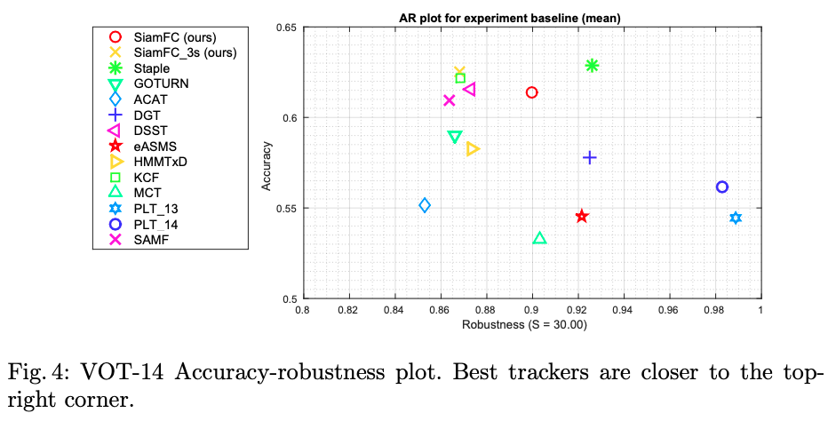
Notes:
Performance Measures: The plot visualizes two key performance measures for tracking algorithms:
accuracy (average Intersection over Union, IoU) and
robustness (total number of tracking failures).
Benchmark Comparison: It compares the SiamFC method and
its variant against other top-performing trackers from the VOT 2014 challenge,
plus two recent real-time trackers, Staple and GOTURN.
simplistic tracker: SiamFC (Siamese FullyConvolutional) and SiamFC-3s, which searches over 3 scales instead of 5.
Symbols: Each symbol on the plot represents a different tracking algorithm,
with SiamFC highlighted as the method of the presenters.
Desired Location: The closer a tracker's symbol is to the top-right corner of the plot,
the better its performance in terms of both accuracy and robustness.
Results Interpretation: The plot indicates that while some trackers offer higher robustness (further right),
they may sacrifice accuracy (lower on the y-axis), and vice versa.
The best trackers find a balance, achieving high marks in both criteria.

